Slide 1

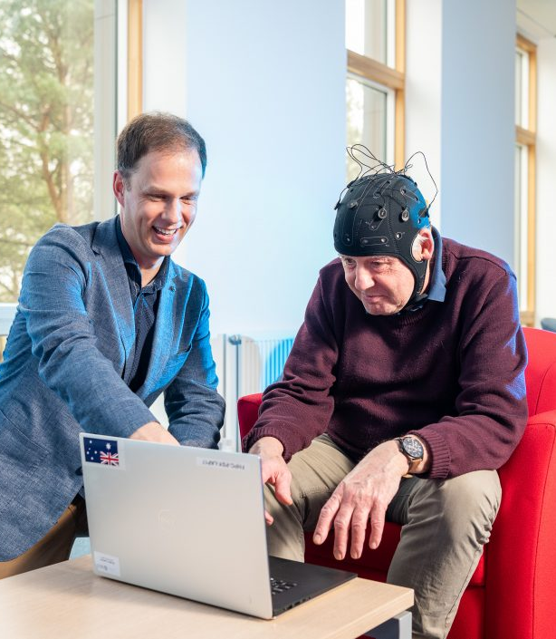
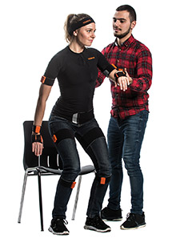
The Effect of Personalised Exercise Intervention
on the Progression of Young Onset Dementia
HREC approval number: 14091
Are you living with young onset dementia (YOD)? We invite you to participate in our research project aimed improving the lives of individuals with young onset dementia.
Project Description:
In this project, we will record your movement and brain activity using sensors while you do simple standing and walking tests. Some participants will take part in a 12-week exercise program with an exercise expert. After 12 weeks, everyone will be tested again to see how the program affects the body and brain. You and your carer will also fill out quality-of-life questionnaires at the start and end of the 12 weeks.
Project Aim: This project will study how exercise affects the progression of YOD and the quality of life of both participants and their carers.
Benefits of Participation:
Take part in a 12-week exercise program with personal support and home visits from an exercise expert.
Everyone will get the program by the end of the study.
You will receive $50 gift cards as a thank-you for participating.
If you are interested in participating:
You must be diagnosed with Young Onset Dementia.
You are able to walk and move independently.
You and your carer must consent to participating in the project
If you are interested in taking part or in this research or would like further information, please contact:
Maryam Ghahramani, main investigator, Email: Maryam.Ghahramani@canberra.edu.au +61421217033

